Slide 1
NIH DMS Plan
Budget Updates

Slide 2
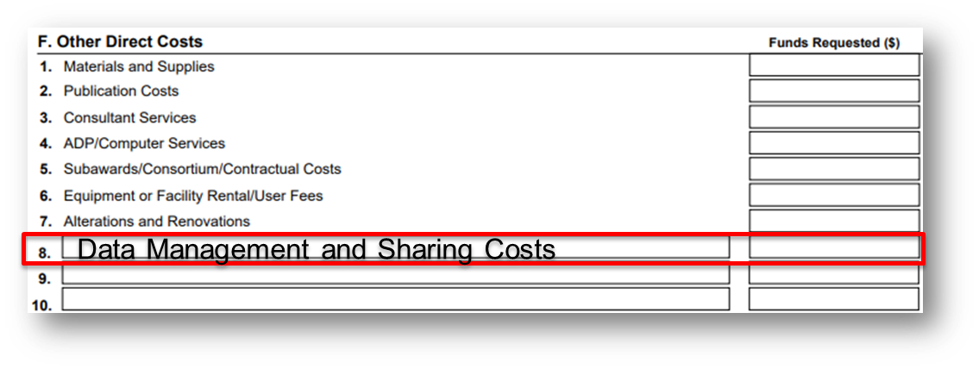
R&R Budget Form
Direct costs to support activities proposed in DMS Plan must be indicated as “Data Management and Sharing Costs”
R&R Budget Form: line item in section F. Other Direct Costs
Do not combine DMS costs with any "Other" costs.
If no cost will be incurred, enter "0" in the "Funds Requested" column.

Slide 3
PHS 398 Modular Budget Form
PHS 398 Modular Budget Form: within Additional Narrative Justification

Slide 4
Budget Justification
Brief summary of DMS Plan and description of DMS costs (recommended ≤ ½ page) must be included within the budget justification attachment; peer reviewers may comment on requested DMS costs based on this information
R&R Budget Form: section L. Budget Justification
PHS 398 Modular Budget Form: Additional Narrative Justification

Slide 5
Q: What do I need to include in the budget justification?
Label a section of the budget justification as :In a section clearly labeled "Data Management and Sharing Justification."
Enter the requested dollar amount
Enter "0" for the requested dollar amount if no cost will be incurred
Provide a brief justification of the proposed activities that will incur costs
Provide a summary of type and amount of scientific data to be preserved and shared and the name of the established repository(ies) where they will be preserved and shared. Indicate general cost categories such as curating data and developing supporting documentation, local data management considerations, preserving and sharing data through established repositories, etc., including an amount for each category and a brief explanation.
The recommended length of the justification should be no more than half a page

Slide 6
Q: What if I do not plan to incur any data management and sharing costs?
On the R&R Budget page, you will need to add the line item, “Data Management and Sharing Costs” and put “0” in the funds requested section.
In the budget justification, note that no data management and sharing plan costs are anticipated.

Slide 7
Additional Information
NIH Data Management & Sharing Policy FAQs
NIH Forms-H Application Guide

